Slide 1
3 eras, 3 metaphors, 3 models
Era of abundance (before 1973)
infinite frontier
cowboy economy
Era of energy constraints (1973-2008)
severe economic havoc wrought by OPEC oil embargo
Age of resource depletion (2008 on)
spaceship earth

Slide 2

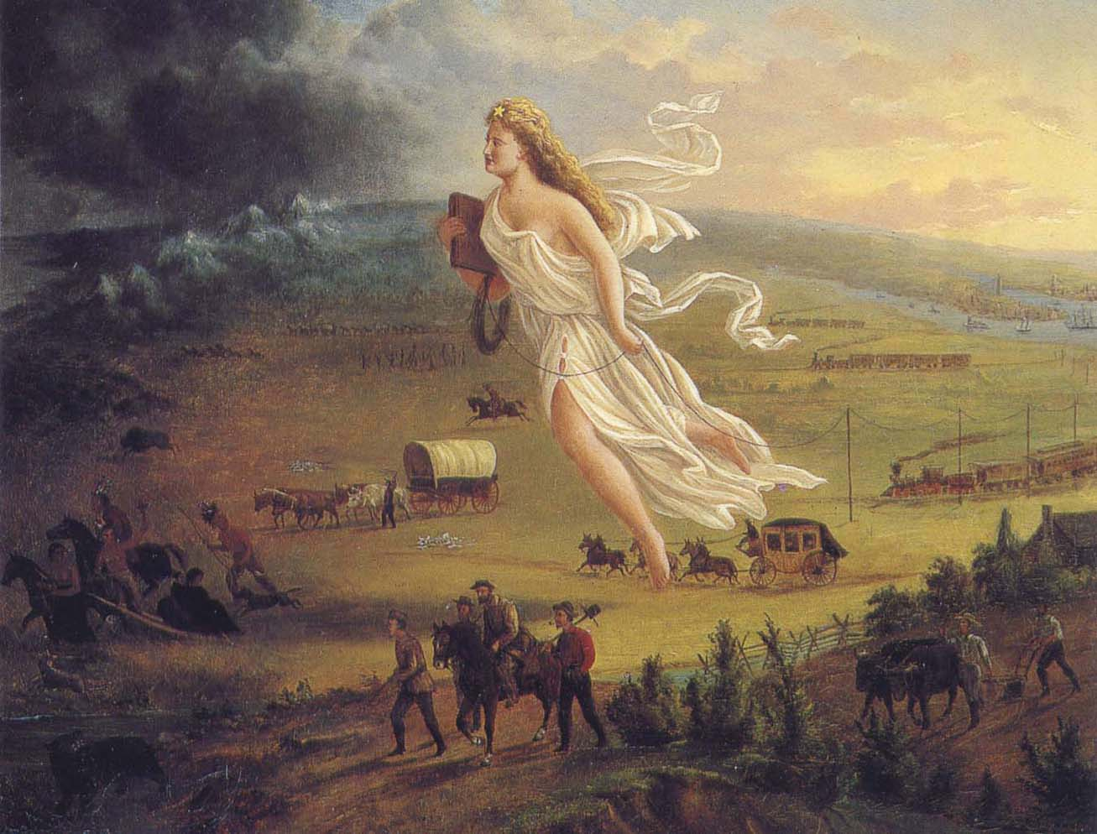

Era of abundance
Population pressures spurring the western expansion were soon forgotten in a seemingly infinite land of bounty

Slide 3
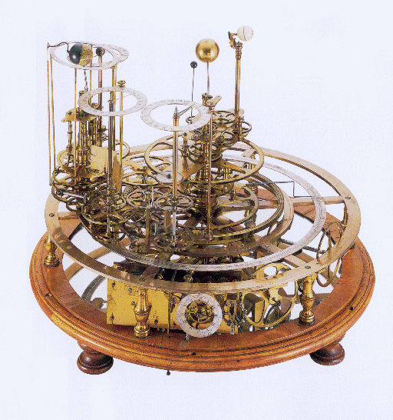

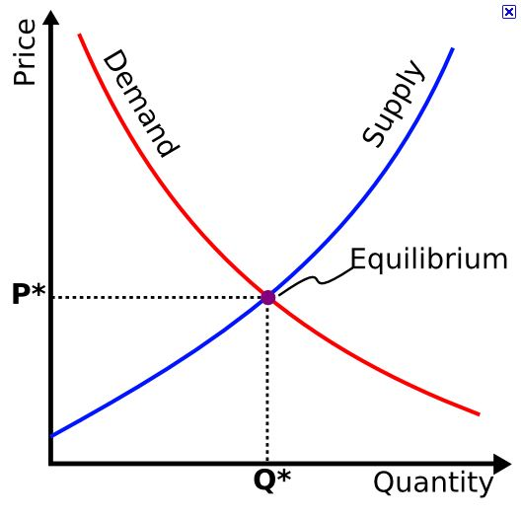
Era of abundance
Guiding metaphor:
If the universe runs like clockwork, so too must the economy

Slide 4
Era of abundance
Circular economy independent of biosphere
Households:
exchange labor and capital for income
purchase goods and services from producers
Perpetual motion of 1st kind

Slide 5
National accounting
Systems of national accounts (input-output tables) were established to:
Track flows of money (proxy for goods and services) between different economic sectors,
Calculate economic ‘health’ mainly via GDP

Slide 7
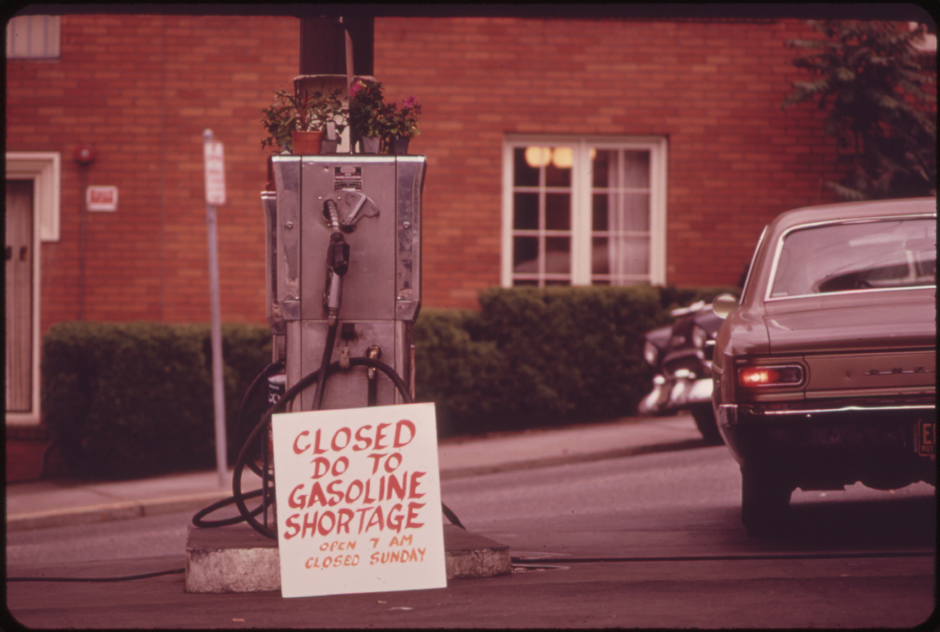

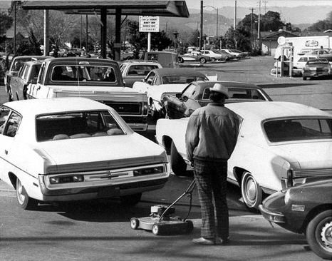
Era of energy constraints
The 1970s OPEC oil embargos caused havoc to industrialized nations

Slide 8

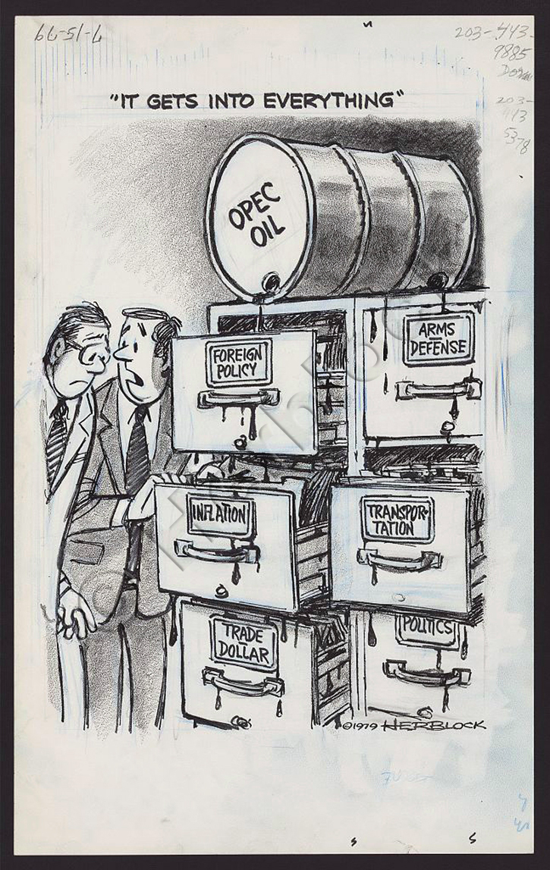
The belief vs. reality

Slide 9
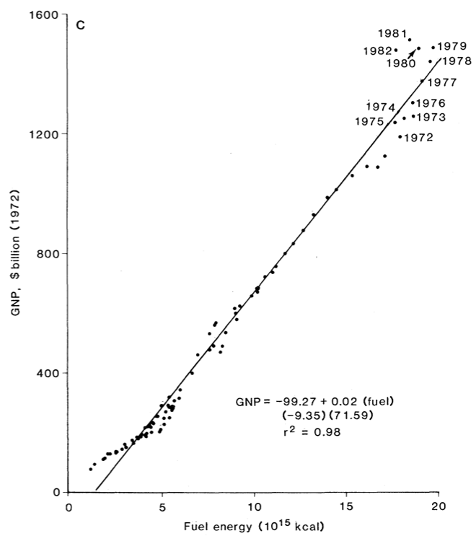
The belief vs. reality
Cleveland et al. (1984) Science, 225, 4665, pp.890–897

Slide 10

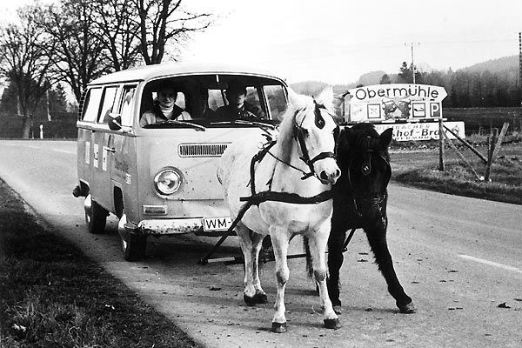
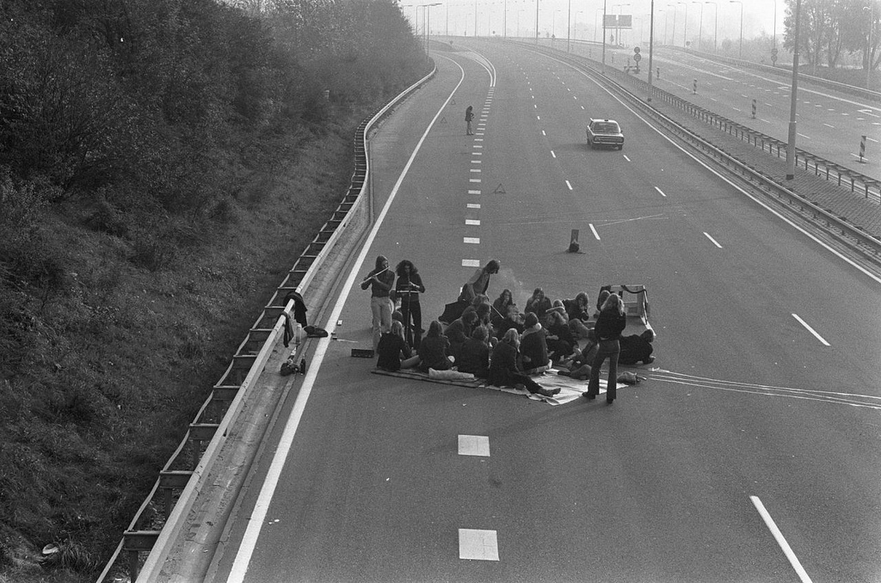
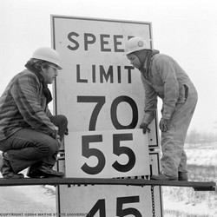
Some responses
Rationing and bans on Sunday driving
Alternative fuels
CAFE standards
Lower speed limits

Slide 11


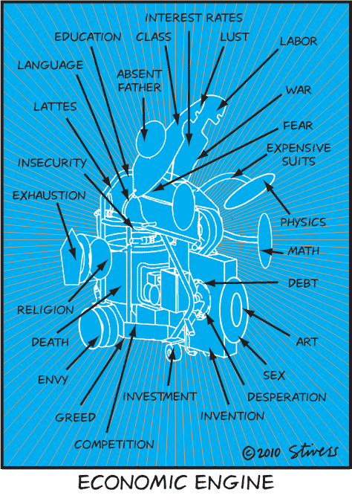

Era of energy constraints
A new metaphor:
The economic engine

Slide 12
Era of energy constraints
Energy from the biosphere ‘fuels’ the ‘economic engine’
No other materials are needed
No wastes are produced
Perpetual motion of 2nd kind

Slide 13
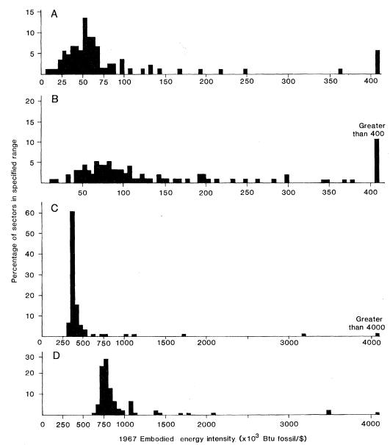
Updated national accounts
Formation of International Energy Agency (IEA) and the US Energy Information Administration
Energy input-output methods calculate ‘embodied energy intensity’ of economic sectors
Costanza (1980) Science, 210, 4475, pp.1219-1224

Slide 14
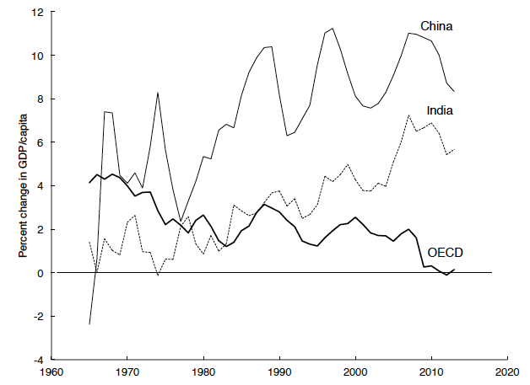

A new age…
However, economic growth has slowed in mature economies
The economy is tightly coupled to the biosphere
We are depleting stocks of natural capital

Slide 15
Properties of economies
intake material and energy from the biosphere;
exchange materials, energy, and information internally;
discharge material and energy wastes to the biosphere;
are affected by energetic costs;
are affected non-linearly by scarcity in the face of low substitutability;
can change non-linearly or in discrete steps with the potential for structural transformation;
accumulate embodied energy in material stocks; and
maintain organizational structure despite changes in their environment

Slide 16

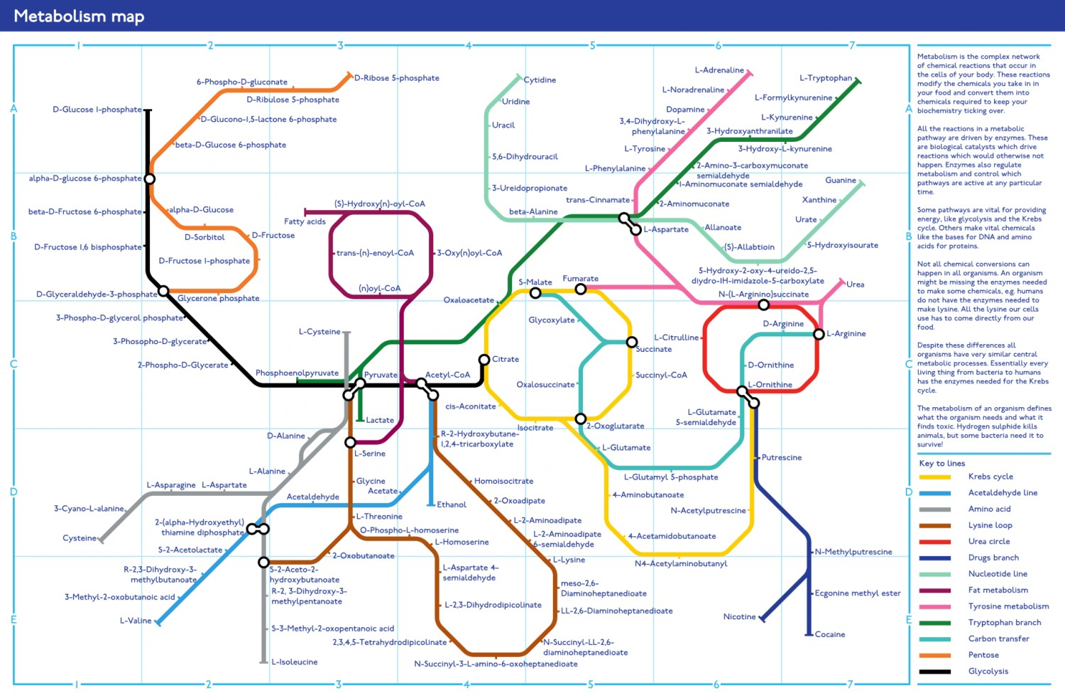
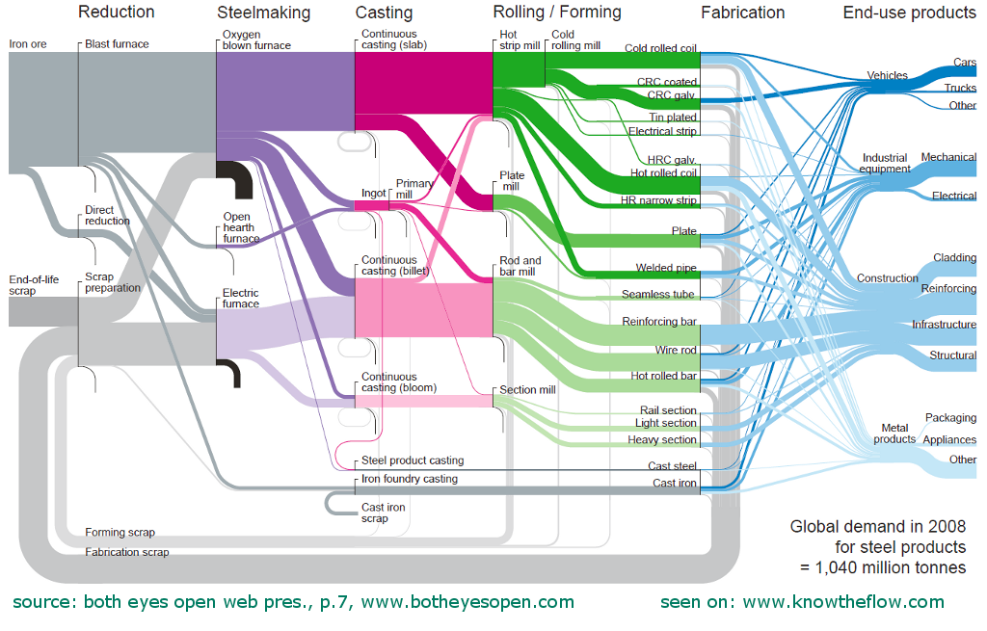
A new metaphor…
Metabolisms share these properties
The economy is society’s metabolism

Slide 17
Age of resource depletion
Materials and energy resources from biosphere
Wastes produced by all economic processes

Slide 18
National accounting for the age of resource depletion
UN System of Environmental-Economic Accounts (SEEA)
Includes material and energy inputs and emissions of waste
Defined at the economy-wide scale

